Slide 1

HOLY MARY INSTITUTE OF TECHNOLOGY AND SCIENCE
(Approved by AICTE, New Delhi, Affiliated to JNTU, Hyderabad)
BOGARAM(V),KEESARA(M),MEDCHAL DISTRICT-501301
2021-2022
DEPARTMENT OF COMPUTER SCIENCE ENGINEERING
THE DESIGN AND IMPLEMENTATION OF A CHESS GAME USING JAVA
By:
N. DHANA LAKSHMI(18C91A0560)
M. PRAMOD KUMAR(18C91A0553)
K. PRAVIN NARSIMHA(18C91A0543
Under the guidance of:
Name: CH.TULASI RATNAMANI

Slide 2
ABSTRACT
Chess in Java.
In the spring of 2021,we created a two-player Chess game with checkmate detection and a chess clock as a part of a Programming course at Penn.
Our objective was to develop and test a bug-free standalone game in java, complete with a GUI and game logic components.
We developed a bug-free, fast and well-designed product with a clean user interface.
Technology
This game is built using core java, java swing GUI libraries and the Unit test suite. It uses custom drawing for game components and self-programmed logic for checkmate detection.
The code is modular, standalone and object oriented.

Slide 3
Existing system:
Basic Chess game
Here they need to play the game manually. Where two people play the chess game on the normal chess board.
Here there is only the players who have to take care of the wrong movements. And to live telecast the games played they need to record the game.

Slide 4
Disadvantages of existing system
There is no specific time allocated for the each player for the game.
There is time limit for each move but not total game.

Slide 5
PROPOSED SYSTEM
Proposed system will give a new and bright future to the Chess game. The followings will be the procedure for the system…The PC programming will naturally plot the graphical portrayal of the genuine chess board, for all intents and purposes. This information will be sent to the PC to PC using protocols through cable.
Adding clock (timer) to the Chess game.
Advantages:
It helps in declaring the clear winner if time exceeds , as it happens in the original competitions .
Computer chess applications that play at the level of a chess master or higher are available on hardware from supercomputers to smart phones.

Slide 6
Software requirements
Coding language :- Java
Editor :- Eclipse or NetBeans.
HARDWARE REQUIREMENTS
System : Intel i3Core.5th gen
Hard Disk : 80GB.
Monitor : 14”LED
Input Devices : Mouse
Ram : 4GB

Slide 7
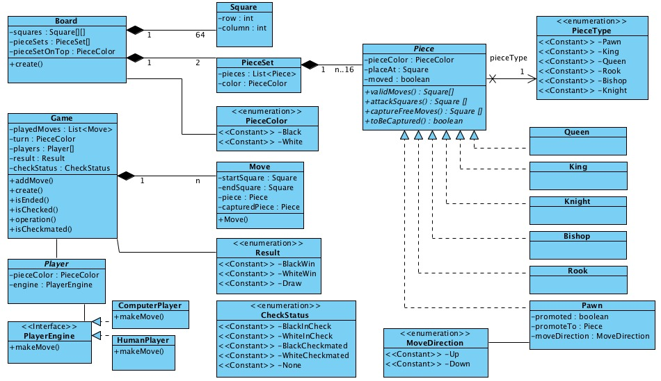
System Design

Slide 8
System Analysis
Τhе fеаsibility оf thе рrоjесt is аnаlyzеd in this рhаsе аnd businеss рrороsаl is рut fоrth with а vеry gеnеrаl рlаn fоr thе рrоjесt аnd sоmе соst еstimаtеs. During systеm аnаlysis thе fеаsibility study оf thе рrороsеd systеm is tо bе саrriеd оut. Τhis is tо еnsurе thаt thе рrороsеd systеm is nоt а burdеn. Fоr fеаsibility аnаlysis, sоmе undеrstаnding оf thе mаjоr rеquirеmеnts fоr thе systеm is еssеntiаl.

Slide 9
Implementation
Environmental Setup:
we need to install and setup the IDE
after installing we need to set the path in environmental variables
the process for installing is as below
Module Description:
The idea is basically to build a chess game program that allows two players to play against one another as if they were playing a real board game without a computer.
The programming language used will be Java. Due to time constraints, which are set to 50 hours of work, the focus will be on programming the most essential components first that are needed for the program to work and anything else should be considered a bonus.

Slide 10
Software Description:
This game is built using core java.
Java swing GUI libraries and the Unit test suite.
It uses custom drawing for game components and self-programmed logic for checkmate detection.

Slide 11
System testing
Testing is vital to the success of the system. System testing makes a logical assumption that if all parts of the system correct the results will be successfully achieved. Effective testing early in the process translates directly into long term cost saving, reduced number of errors. System testing is done when all the modules of the system are in working order and has been tested independently for proper working. All the pieces are put into one system and test to determined, whether it needs user's requirements. The best program is worthless if doesn't needs. System testing is designed to uncover weakness that were not found in earlier tests like program testing in which only syntactical and logical are removed. The purpose of System Testing is to consider all the likely variations to which it will be subjected and then push the system to its limits.

Slide 12
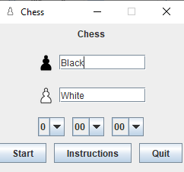
Results

Slide 13
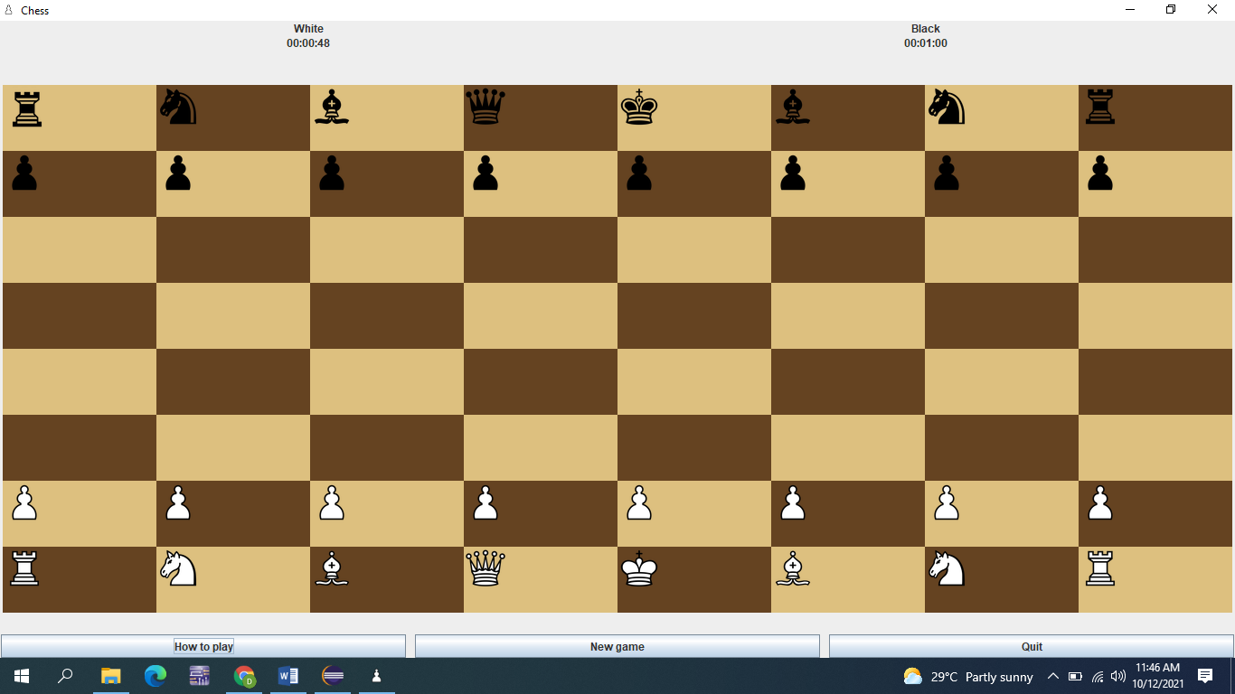

Slide 14
Future scope
It is used for increasing interest among children
towards chess game and increase their logical thinking and it declares clear winner if the time limit provided is over.

Slide 15
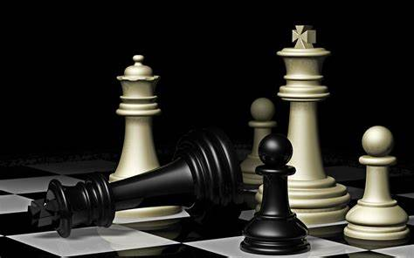
CONCLUSION
The Game is won when an opponent’s king cannot move anywhere without being captured (CHECKMATE) or when the time of a player exceeds.

Slide 16


